Slide 1


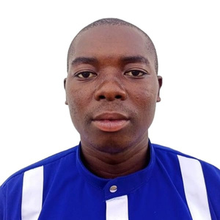
STRAIGHTENING TECHNOLOGY AND EDUCATION ACCOSS THE CONINENT FOR HUMANITY
(Nguvu-TEACH)
introduction
Empowering Africa Through Technology
ALFRED BALAZIRE LURHAKONGOLA
A REFUGEE
FOR 7 YEARS
CONTACT
Email: nguvutech@gmail.com alfredbalaziealba@gmail.com
Contact: +254704659108
LOCATION
Kalobeyei Village3, Near Soko Ya Mboga (WFP Tumaini Market)/Kakuma Municipality/Turkana County/Kenya

Slide 2
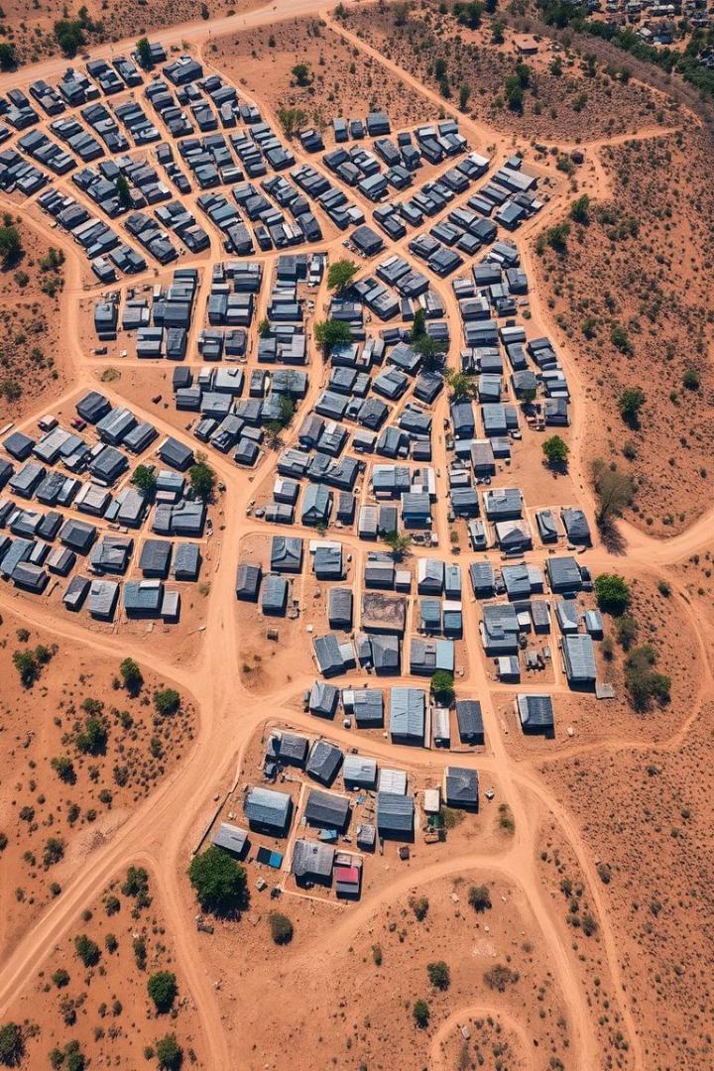

Kalobeyei Settlement Overview
1
Location
20 km from Kakuma Town, established in 2016 to ease overcrowding.
2
Population
38,000 refugees: 40% women, 45% youth, 15% elderly.
3
Challenges
Limited education, high unemployment, overcrowded schools (100-150 students per class), very low level of computer literacy in schools.
Notes:
3

Slide 3
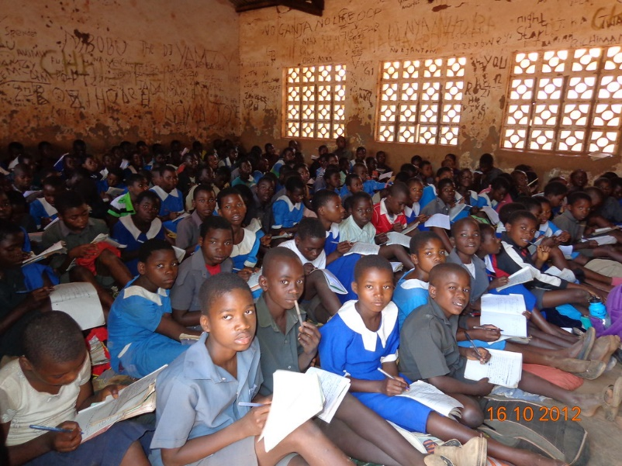
PROBLEM STATEMENT
Inadequacy of Tech and Digital skills Among Refugee Youth
High unemployment
Very low level of computer literacy
Lack of Tech skills
75% according to a recent research
About 85% according to a recent research
90% according to a recent research
The TVET system in Kalobeyei Settlement and its surroundings face challenges like shortage of quality institutions, outdated curricula, and high costs.
These issues hinder access for refugees, particularly those who fail their KCSE exams and lack university options. The failures are mostly contributed by strenuous learning conditions in the secondary schools around Kalobeyei Settlement.
Our survey reveals that 85% of these youth turn to criminal activities, 75% of girls engage in sex work, and 90% become teenage mothers, increasing their vulnerability to health risks.

Slide 4



NGUVU-TEACH Solution
As a solution to these challenges, Nguvu-TEACH as a local EdTech startup will do the following:
Education
& Training
Entrepreneurships
Link To Job Opportunities
We will have training and courses that will help the youths live with good Tech & Digital Skills. Our courses will be from basic computer training to web design etc.
Training them to use the skills they learn to generate income for themselves
We will partner with organizations both in the camp and online and connect those who eccel in the trainings to job opportunities
At the End of this proposed solution in 2025, Nguvu-TEACH vision is to empowered up to 500 youths, making them self Reliant, self-employment or even get employed. This is projected to bring down the unemployment rate in Kalobeyei Settlement from 75% to 60% my 2025 and 30% by 2030.
OUR MISSION
NGUVU TEACH: Tech For All Everywhere

Slide 5
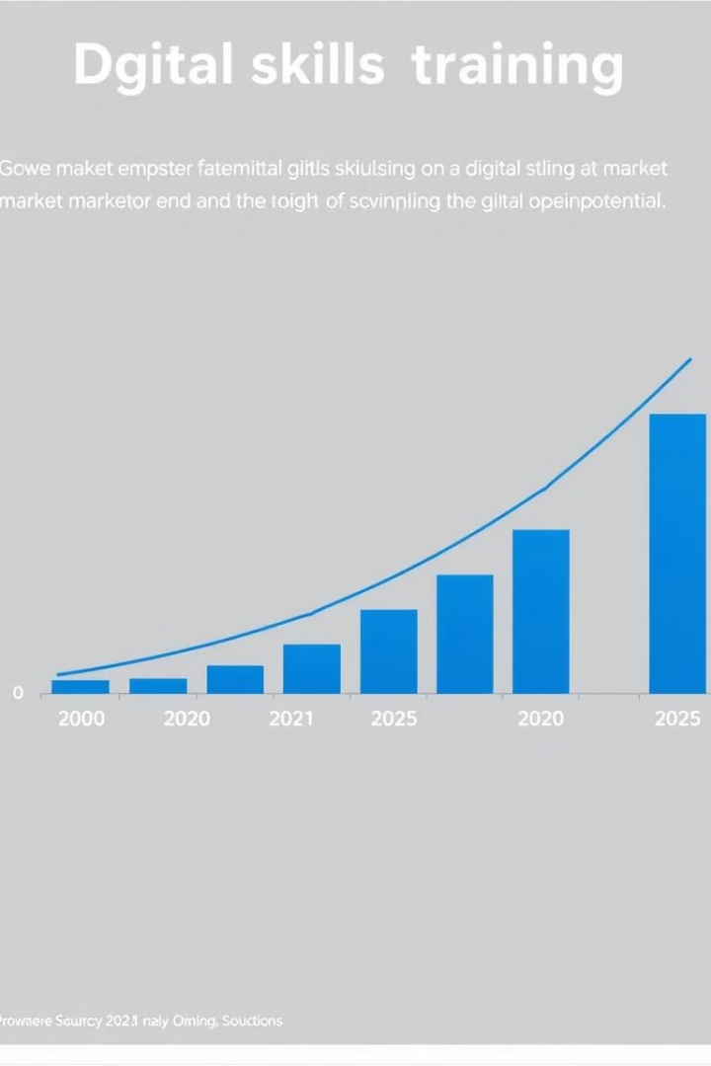



Market Size
Youth Population
45% of Kalobeyei' s population are youth, creating high demand.
Growing Market
Global demand for digital skills training is increasing.
Potential Partnerships
Opportunities for grants and partnerships(Investment , Donations)to expand reach.
Notes:
8

Slide 6
OUR ASK
INCOME
135,000 USD
in grant or partner equity
Ways to generate revenue:
Partnership with LWF to teach Basic & Intermediate ICT for them
Refugee Students:
Basic Computer Training: ($15 Monthly for 6 Months)
Intermediate Computer Training: ($25 Monthly for 6 Months)
Graphics Design: ($50 Monthly for 6 Months)
Web Development/Software Engineering: ($100 Monthly for 6 Months)
Other digital trainings: $35
Cyber services (Printing, photocopy, Browsing Services, Ethical hacking)
Things we need the money for:
Facility Renovation: 15%
Build an Online Learning Management System(LMS): 35%
Computers & Accessories: 25%
Furniture: 2%
Power & Utilities: 3%
Staff Acquisition & Facilitation: 20%

Slide 7




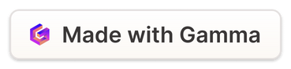
Revenue Model
Student Fees
Income from digital skills and entrepreneurship programs fees.
Partnerships
Funding and grants from strategic partnerships and Intors.
Digital Services
Revenue from web designs, software systems vending and graphic designs for local businesses.
Notes:
11

Slide 8
Value Proposition
Nguvu-TEACH’s Unique Value Proposition: Nguvu-TEACH offers refugees a holistic approach to personal and professional growth by combining Digital Skills Training with entrepreneurship education. Our programs are specifically tailored to meet the needs of refugees and are designed to lead directly to employment and self-reliance.
COMPETITION
Company | Tech Training | Entrepreneurship | Link to Job Opportinuty | Cyber Services(printing, Lamination, Typing, Ethical Hacking etc.) | Online Sessions
Kalobeyei Computer center | V | X | X | V | X
Youth Cyber | X | X | X | X | X
Nguvu-TEACH | V | V | V | V | V

Slide 9

Traction
Success Rate
2
3
Students Trained
Partnerships
54 students being trained on Advanced Digital skills(Web Development, Graphic Design, Multimedia and Digital Marketing) and 2 Students Being Trained Online on Web Development Only.
80% of graduates are able to develop various Websites and various Designs with Canva and Adobe photos shop to earn a living
1
Established strategic partnerships with local and international organizations such as LWF Kenya
Notes:
10

Slide 10
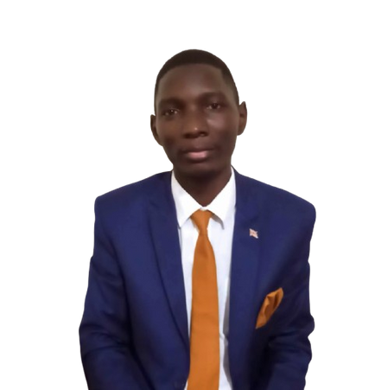
OUR TEAM
Alfred Balazire Lurhakongola
Founder and CEO
Frontend Engineer and Web Designer
Over 3 years of technical experience
Felix Ayot
Technical Mentor and Instructor
Software Engineer
Over 3 years of technical experience

Slide 11
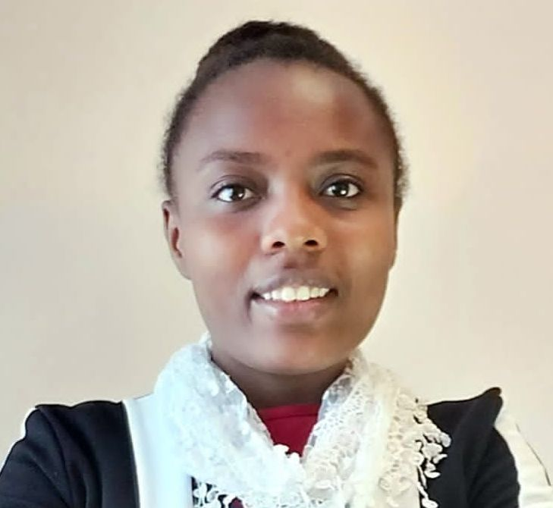
OUR TEAM (Cont.)
Zawadi Blandine R.
Partner
Graphics Designer and Business Owner
Over 3 years of professional experience

Slide 12
THANK YOU FOR YOUR WILLINGNESS TO SUPPORT REGEES

